Slide 1
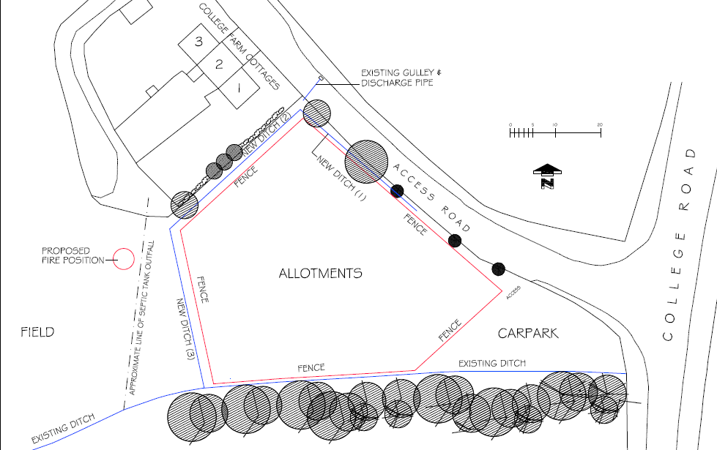
Allotments drainage action plan
Proposed solution:
Dig a ditch around three sides of the allotments (in blue on the plan)

Slide 2
Steps
Clear ground along route of proposed ditch
Allotment volunteer working party and others
Cut back overhanging branches and any small trees along route of ditch and remove branches and cutting to proposed fire position
Volunteer safe working party with chainsaws etc
Create ditch with tractor mounted trenching bucket and use spoli to create banks either side of ditch
Volunteer - Phil
Repair fencing around perimeter of allotments or replace with deer proof fences – To Be Decided.

